Slide 1

DATABASE

Slide 2

Objectives
State what is a database
Describe different types of databases
Compare and contrast types of Databases
State what is a relational database
Describe different types of keys used in a relational database
Define data types used in databases

Slide 3


What is a database?
A database is a collection of data that can be searched in a systematic way to maintain and retrieve information
It can be termed as a container that stores data
Used in the computer context and exist in digital form, so it is a computer-based record keeping system

Slide 4
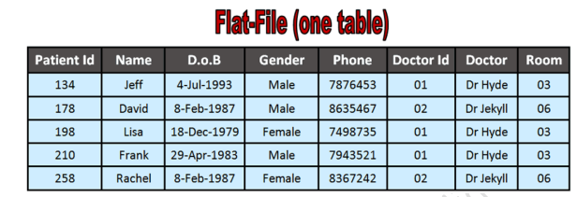
Flat-file Database Model
The flat model is the earliest, simplest data model.
It simply lists all the data in a single table, consisting of columns and rows.
Characteristics
Data redundancy – the needless and unnecessary duplication of data
Data inconsistency – errors in the values or format of data that should be identical
Access inefficient: In order to access or manipulate the data, the computer has to read the entire flat file into memory
Simple database: Can only be used for small data set

Slide 5
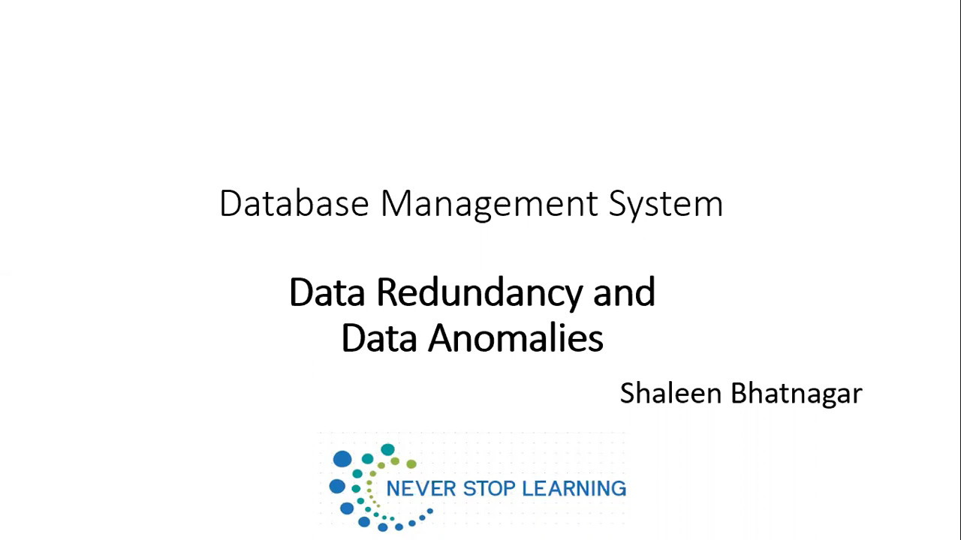
Review Video

Slide 6
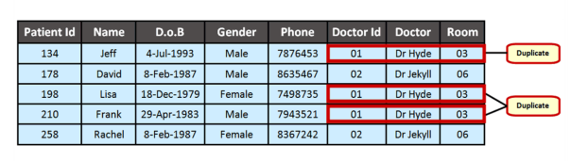
What is Data Redundancy?
Data Redundancy is where you store the same data many times (duplicate data) in your table.
This repeated data needs to be typed in over and over again which takes a long time.
For example:-
The patient's database contains several entries of duplicate data:
Doctor Id
Dr. Hyde
Room 03

Slide 7



Let’s find out together

Slide 8
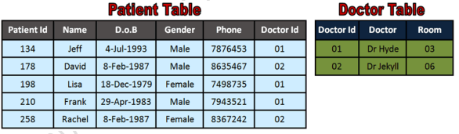
Relational Database Model
The most common model
Relational Databases use two or more tables linked together (to form a relationship). It uses multiple table to store data

Slide 9

Watch the following video and then answer the following questions

Slide 10
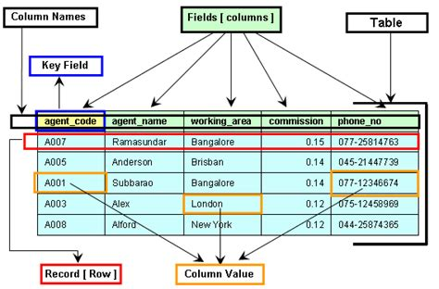
Relational Database Concepts
Data is stored in TABLES, which consists of many RECORDS and each record consists of several FIELDS which has many different DATA TYPES.

Slide 11
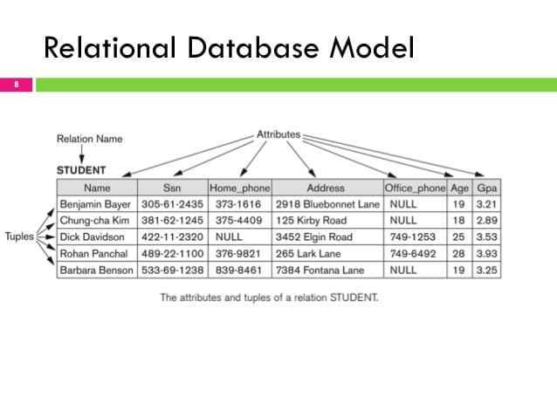
Elements of Relational Database
Entity- A database entity in a relational database refers to a real-world object, concept, or thing that can be distinctly identified.
Example in a database for a library, entities could include books, authors, borrowers, and so on.
Each entity is typically represented as a table in a database, where each row corresponds to an instance of that entity.
A table is a collection of related data organized into rows and columns. It is one of the most fundamental database objects and is used to store structured data.
Tuples – A single entry in a table. It is also called a record or a row
Attributes-the column are called attributes, which describes each tuples. Also refers to as fields

Slide 12
Key Relational Database terms
Tuple: Also known as a "row" or "record," a tuple is a single entry or data point within a table. It represents a specific instance of an entity. In a table, a tuple contains values for each attribute defined in the table.
Attributes: Attributes are the characteristics or properties that describe a particular entity. In the context of a database table, they correspond to the columns. Each attribute defines a specific type of information that can be stored for each tuple (row) in the table. For example, in a "Person" table, attributes could include "Name," "Age," "Address," etc.
Record: A "record" is another term for a tuple. It refers to a single instance or data entry within a table, containing values for each attribute. This term is sometimes used interchangeably with "tuple" or "row."
Field: A "field" is another term for an attribute. It refers to a specific piece of data within a record (tuple). Each field corresponds to a column in a database table and holds a specific type of information.

Slide 13
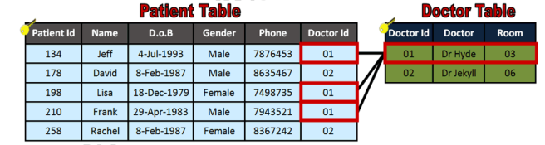
Table Relationship
Relational Databases use two or more tables linked together (to form a relationship).
Relational Databases do not store all the data in the same table.
Repeated data is moved into it's own table
How do you form the relationship? (link the tables)
In order to link the tables, we need to use a common field.
A common field is data that appears in BOTH tables.

Slide 14

Database keys

Slide 15
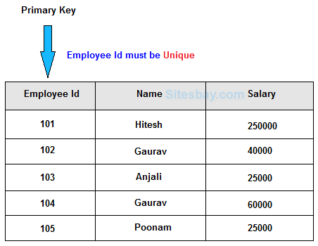
Primary Key
A Primary Key is a column(s) within a relational database table that uniquely represents each record in the table.
For example, the ideal primary key for a table of students would be their ID number, as this would uniquely identify each student in the table.
The main purpose of having a primary key is to identify each unique record in a particular table.
This makes it far easier to search and identify records

Slide 16
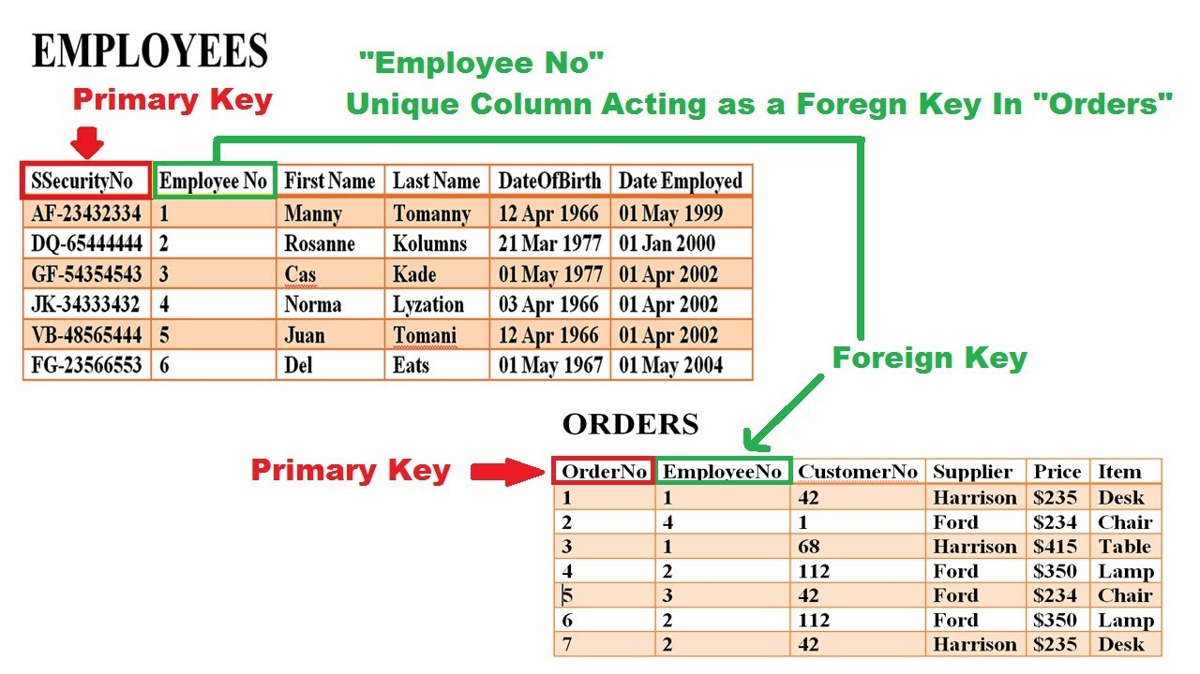
FOREIGN Key
A foreign key is a key used to link two tables together. This is sometimes also called as a referencing key.
A foreign key is a column or a combination of columns whose values match a primary key in a different table.

Slide 17
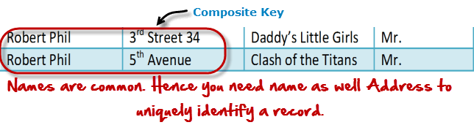
Composite key
A composite key, is a combination of two or more columns in a table that can be used to uniquely identify each row in the table.
Being unique can only be done when the columns are combined;
If the column are taken individually by themselves then the columns are not unique.

Slide 18
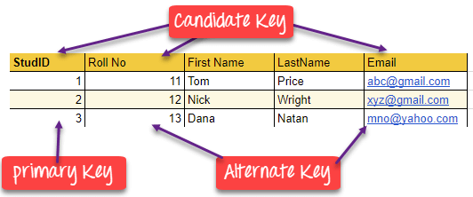
Candidate key
A candidate key is a column or a set of columns that can qualify to be used as a primary key in the database.
There can be multiple candidate keys in a database relation and each candidate can work as a primary key for the table

Slide 19
secondary key
A secondary key, also known as an "alternative key" or "non-primary key," is a field or combination of fields in a database table that can be used to identify records. Unlike a primary key, a secondary key may contain duplicate values.
For example, consider a database of students where each student has a unique student ID (which would be the primary key).
The students' names could also be used as a secondary key, even though names may not be unique. This secondary key could still be useful for searching and organizing the data

Slide 20
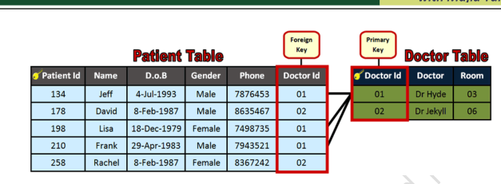
Tables Relationships
A relationship refers to the logical association or connection between two or more tables based on a common field or set of fields. These relationships are established to represent how data in one table is related to data in another table.
We use both the Primary and Foreign key to link the tables and form a relationship between tables

Slide 21
Referential integrity
Ensures that relationships between tables are maintained consistently. It is a set of rules and constraints that dictate how data in related tables should be handled.
Uses two rules
Foreign Key Constraint: states that a value in one table's foreign key column corresponds to a valid primary key value in another table
Cascading Actions: state that what happens when a related record is modified or deleted. It uses either
CASCADE: if a record in the primary table is modified or deleted, the corresponding records in the related table will also be modified or deleted.
SET NULL: if a record in the primary table is modified or deleted, the foreign key values in the related table will be set to NULL.
RESTRICT/NO ACTION: if a record in the primary table is modified or deleted, the action will be restricted if there are related records in the related table.

Slide 22
Indexing
An index is a separate data structure used to optimize the retrieval of rows from a table.
It can be created on one or more columns of a table to facilitate faster data retrieval.
An index does not have to contain unique values. It can be created on any column(s) in a table, whether or not they have unique values.
While a primary key creates an index on the specified column(s) to enforce uniqueness, indexes can also be created independently of primary keys for various optimization purposes.

Slide 23

Activity- 5 minutes
Research on the main differences between a primary key and an index

Slide 24
Activity- 5 minutes-solution
The main differences between a primary key and an index are
Purpose: The primary key is primarily used to uniquely identify records in a table and enforce data integrity. An index is used to optimize data retrieval operations, making queries run faster.
Uniqueness: A primary key must contain unique values for each record in a table.
An index does not require uniqueness in the indexed column(s).
Constraints: A primary key is a constraint that enforces uniqueness and non-null values.
An index is a performance optimization tool that does not impose constraints on the data.
Number of Keys: There can be only one primary key per table.
Multiple indexes can be created on one or more columns of a table.
Automatic Creation: A primary key implicitly creates an index to enforce uniqueness.
Indexes can be created independently of primary keys for various optimization purposes.

Slide 25

Advantages of a Relational database
Reduce data redundancy
Reduce updating
Data inconsistency – as data is not duplicated, there is no risk of the same data item being stored differently in another record.
Greater data integrity
Interdependence from other application programs
Improved data security
Reduce data entry, storage and retrieval cost
Facilitate development of new application program
Flexibility – A relational database can be queried with greater flexibility than a flat-file system.

Slide 26
Disadvantages of a Relational database
Database systems are complex, difficult and time consuming to design
Substantial hardware and software start up cost
Damage to database affects virtually all application program
Extensive conversion cost in moving from a flat file database model to relational database model
Initial training required for all programmers and users

Slide 27

Activity 3
Complete task 2 questions on worksheet

